Slide 1

Communication and Information Studies
5 November 2024
UvA Master’s Week 2024
Program director:
Dr. Corina Andone
C.Andone@uva.nl
Also online:
Katerina Xerovasila, current student doing an internship (xerovasilakaterina@gmail.com)

Slide 2



What is communication and information studies about?
The programme provides students with a solid theoretical and methodological foundation for understanding the way in which language is used for informative and persuasive purposes.
politics
health
science
Students are trained in analysing and evaluating the discourse in these communicative practices by using insights from discourse analysis, argumentation theory, rhetoric, genre theory and stylistics.

Slide 3

Theory and practice
Communication and Information Studies:
is a 1.5 year professional master programme
two parts:
  (a) one academic year of courses
  (b) one semester consisting of an internship in a professional organisation.

Slide 4

Study scheme
The academic year = two semesters of three periods each.
  Block 1 and 2 of each semester are "lecture periods"
  Block 3 is an "individually-oriented work period".
  Lecture periods consist of six weeks of classes followed by an exam week; individual work periods are four weeks long.
ECTS, the European Credit Transfer System
  1 EC = 28 hours of work.
  30 EC per semester = about 40 hours per week

Slide 5
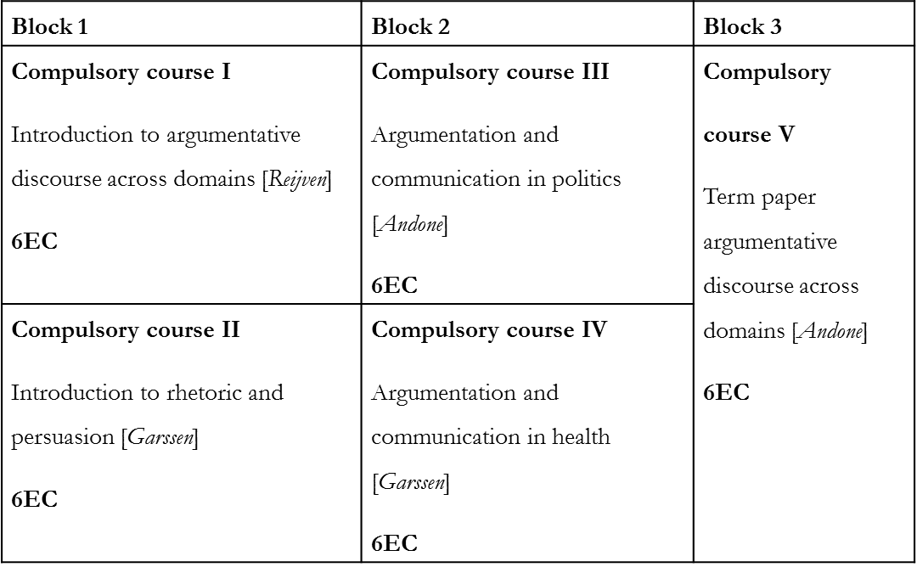
Study scheme
Year 1, Semester 1

Slide 6
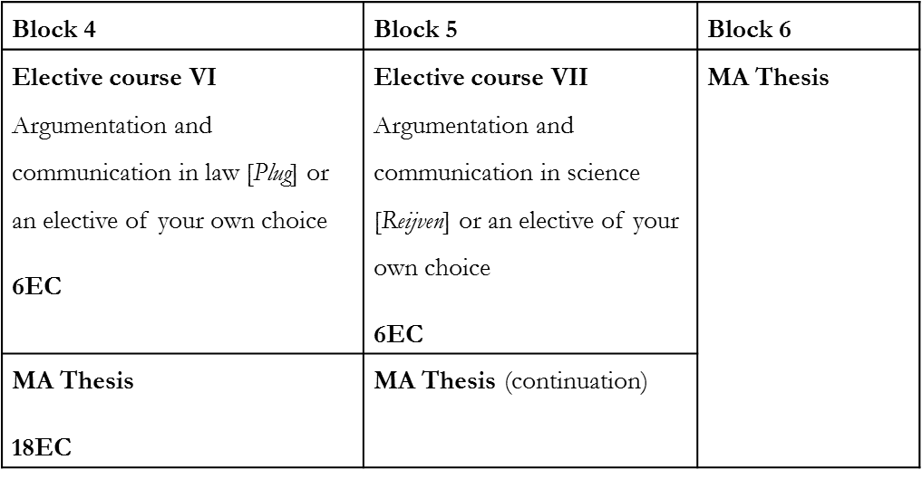
Study scheme
Year 1, Semester 2

Slide 7
Study scheme
Year 2, Semester 1
Block 1 | Block 2 | Block 3
Internship 30EC

Slide 8
Examples of course descriptions
In order to create a strong common academic background for all students, the programme starts in semester 1 with two introductory courses:
1. Introduction to Argumentative Discourse across Domains: the theoretical and empirical insights for the study of argumentation in various communicative domains.
2. Introduction to rhetoric and persuasion: an introduction into theories of effective language use from antiquity to modern times.
Courses situating communication in specific contexts, in which you apply the methods and theories from the introductory courses
3. Argumentation and Communication in Politics: a systematic overview of the main discursive approaches to political interviews, election debates, parliamentary debates, political speeches, social media and policymaking.
4. Argumentation and Communication in Health: the argumentative and stylistic properties of the medical consultation, the health brochure and the consumer medicine advertisement.

Slide 9

Examples of theses
Legitimizing state surveillance: A pragma-dialectical analysis of security arguments (Katerina)
Corporate Response Strategy during Greenwashing Crisis: a case study of Image/Brand Trusts Repair strategies
Strategic constructions of corrective action in Shell’s 2020 sustainability Corporate Social Responsibility report
Corporate Social Responsibility in the European Fashion Industry: Social Identity Framing’s Role in Communicating Brand Identity and Influencing Consumer Support in Press Releases
A critical case study analysis of political discourse aimed at legitimising neoliberal education reforms

Slide 10

Examples of internships
National and international professional organisations
the United Nations Headquarters in New York
Dutch Research Institute for environment and public health
European Parliament
International Debate Education Association
International Criminal Court
copy writing agency for political speeches
publishing houses
musea
internal communication (speech writing) ING
many private companies

Slide 11
Special features
a unique combination of discourse analysis and argumentation theory
external internship (1 semester) to develop practical skills and competences for a future career and to gain work experience
a selective admission process for the programme, ensuring that students are able to comply with the standards of the programme
established researchers: latest research results
small-scale education: close interaction with the lecturers, individual tutoring (max. 30 students are allowed)
international environment with Dutch and international students: very diverse students in terms of background, nationalities, approaches
good reputation
forming qualified professionals

Slide 12

Admissions
BA in the humanities and/or social sciences
at least one course during the Bachelor’s phase in the broad fields of communication, argumentation, discourse studies
an average grade of at least 7 in the Dutch grading system or equivalent
motivation letter explaining why you wish to study with us and explaining your suitability for the programme
sufficient level of English proficiency
Specific questions about application and admission
uva.nl/questionform

Slide 13

Application deadlines
1 March 2025
www.gsh.uva.nl
Information about the programme content:
C.Andone@uva.nl

