Slide 1


Identity and Integration
Startpagina
Afbeelding invoegen
1
Wijzig de afbeelding door de bestaande afbeelding te verwijderen. Klik op het pictogram dat vervolgens verschijnt om een afbeelding in te voegen.
2
Selecteer de afbeelding die je wilt invoegen en klik op ‘Invoegen’
3
Selecteer de afbeelding en klik op ‘Hulpmiddelen voor afbeeldingen’ Klik vervolgens bij het onderdeel ‘Schikken’ op ‘Naar achtergrond’.
MA European Studies
4
Wanneer je de afbeelding wilt schalen of verslepen, ga dan naar ‘Hulpmiddelen voor afbeeldingen’ en klik op ‘Bijsnijden’. Met de witte bolletjes schaal je de afbeelding, met de zwarte haakjes schaal je het afbeeldingskader.
Marleen Rensen – 6 November 2024

Slide 2
Programme
20.00: Introduction
  Marleen Rensen
20.20 : Students’ Perspectives
20.40: Questions & Answers
21.00: Closure

Slide 3
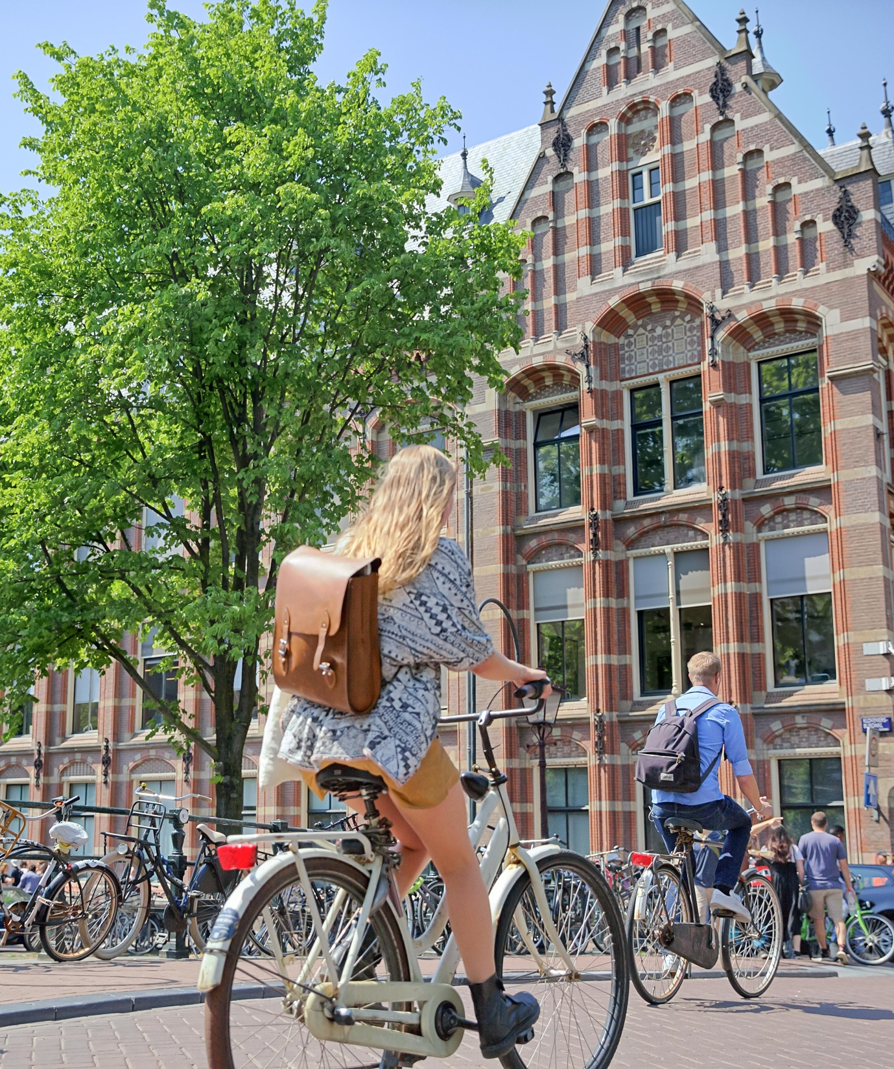
Introducing Identity and Integration
One of three specialised MA tracks in European Studies :
  East European Studies
  European Policy
  Identity and Integration

Slide 4
Introducing Identity and Integration
One of three specialised tracks rooted in the ES department:
  East European Studies
  European Policy
  Identity and Integration
Focus on issues of identity, integration and cultural diversity

Slide 5
Introducing Identity and Integration
One of three specialised tracks rooted in the ES department:
  East European Studies
  European Policy
  Identity and Integration
Focus on issues of identity, integration and cultural diversity
Analyse the role of culture and arts in politics

Slide 6
Introducing Identity and Integration
One of three specialised tracks rooted in the ES department:
  East European Studies
  European Policy
  Identity and Integration
Focus on issues of identity, integration and cultural diversity
Analyse the role of culture and arts in politics
Study contemporary issues from a cultural historical perspective

Slide 7
Programme MA European Studies
 | SEMESTER ONE |  |  | SEMESTER TWO
 | Block 1 (8 weeks) | Block 2 (8 weeks) | Block 3 (4 w.) | Block 4 (8 weeks) | Block 5 (8 weeks) | Block 6 (4 w.)
Course 1 | Imagining the Nation : Cultures of Nationalism (6 EC) | Imagining Europe: Ideologies and Power (6 EC) | Skills Workshop European Capitals of Culture (6 EC) | MA Thesis (18 EC)
Course 2 | Course 1 (6 EC) | Course 2 (6 EC) |  | Course 4 (6 EC) | Course 5 (6 EC)
Two Core Courses + Skills Workshop (18 EC)
Two Restricted–Choice Electives (12 EC)
Two Free-Choice Electives (12 EC)
MA Thesis (18 EC)
UvA Master’s Week November 2022 European Studies

Slide 8
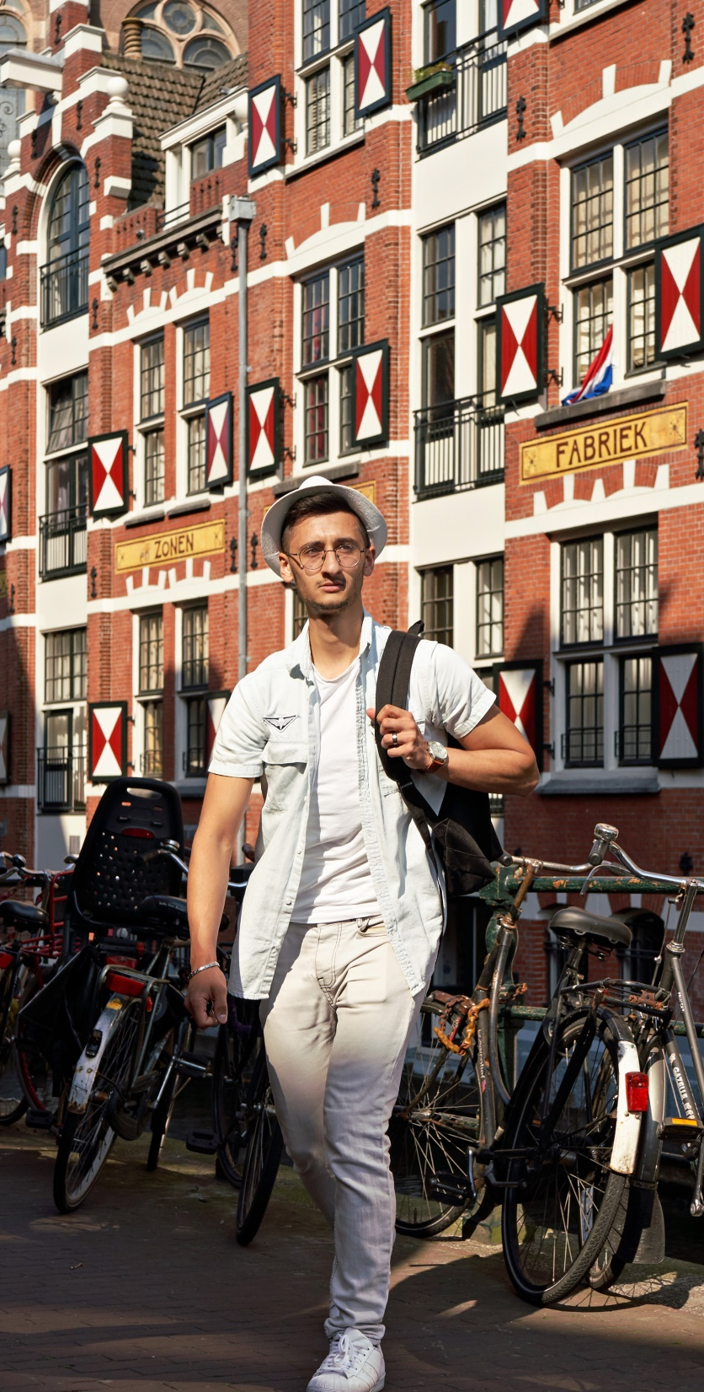
Programme-bound (=‘restricted choice’) electives
      Examples
      Europe and its discontents: A Political History of Iliberalism
      East-West Perceptions in Post-Communist Europe
      Which lives matter? Narratives and experiences of humanity and ‘human’ rights in Europe
      Religion, Violence and Conflict Resolution

Slide 9
Identity and Integration offers:
A cultural historical perspective on contemporary issues in Europe
Specialized knowledge of:
  cultures of nationalism and national identities
  ideas of Europe and European identity,
  the political aspects of European cultures,
  the employment of culture in community-building policies and practices in the EU.
A comparative and transnational approach to analyze related issues.
A seminar and (partly sponsored) study trip to one of Europe’s Cultural Capitals.
Opportunities to meet and engage with experts from outside the academic world who give insight into policies and practices.

Slide 10

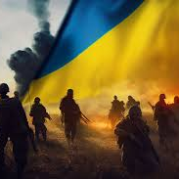
Two examples of ‘Free Choice Electives’
Afbeelding invoegen
      Climate Change in Europe: policy and politics
Ukraine – Battleground for a new Europe?

Slide 11
Students’ Perspectives
Danee van den Heuvel
Georgi Pavlov
Abel Vierhout

Slide 12
Thesis Topics
National Identity in Contemporary Cinema in Cyprus
Surinamese Jazz Musicians in Interwar Amsterdam
The image of Paris in Netflix Series ‘Emily’
Colonialism in Dutch Museums
The Greek MeToo Movement
Bosnian War Remembrance
Comparison of Dutch PVV and Spanish VOX
Climate change in children’s literature

Slide 13
Career Perspectives
Policy officer governance (local, national, European level)
Journalist
Museum curator
Event programmer cultural institution
Officer at publishing house
Phd candidate
Policy officer migration and refugee center

Slide 14
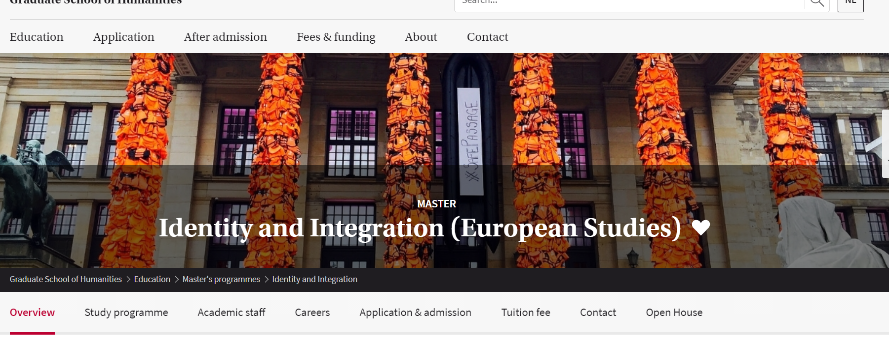
Question and Answers
Visit us online:
https://www.uva.nl/shared-content/programmas/en/masters/identity-and-integration-european-studies/identity-and-integration.html

