Slide 1

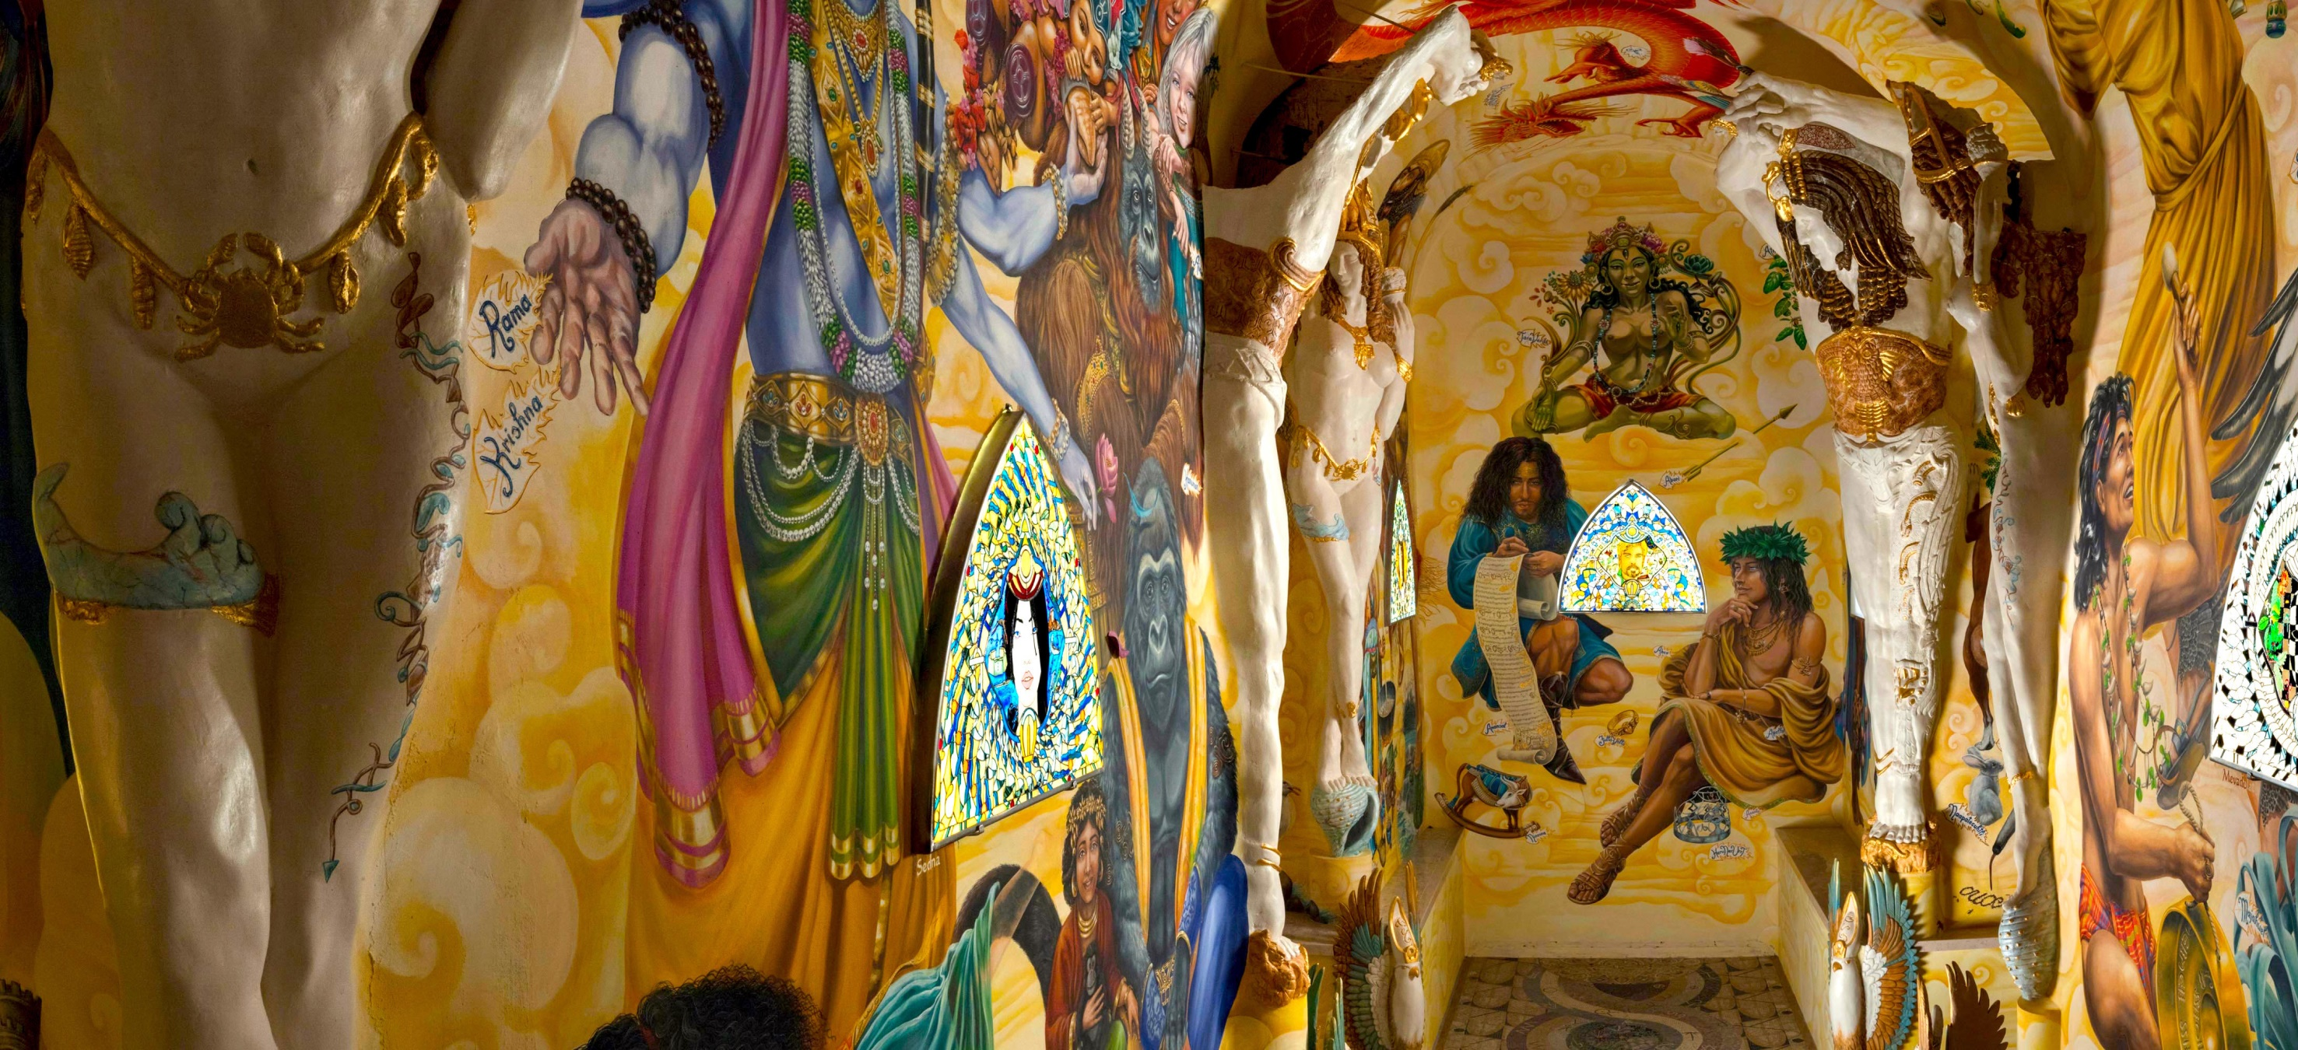
UvA Master’s Day 06/11/2024
MA Theology and Religious Studies
Research MA Religious Studies
Dylan Burns, Peter Forshaw, Tjalling Janssen, and Erik de Vreede

Slide 2
Who cares about religion today anyway?

Slide 3
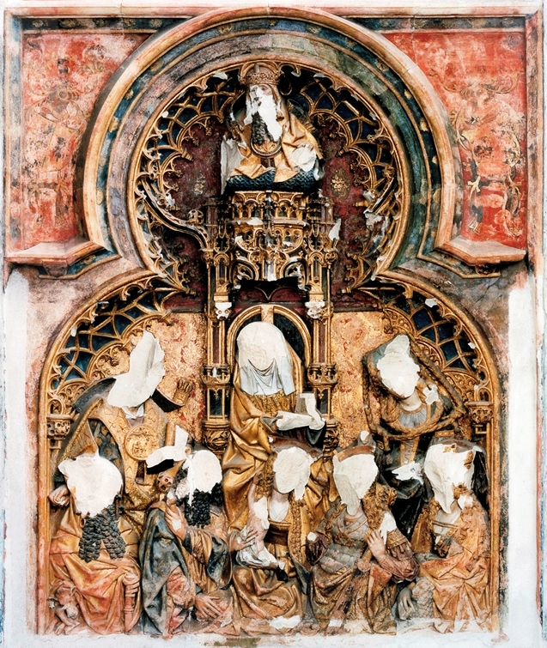
Religion is still very much relevant, and so is its study
We need to understand why people did the things they did in the past, because this is still shaping our present. Very often this has to do with religion!
Religion is still very much around, and makes people do things!
Religion is creativity. We don’t understand the richness of human culture if we don’t take it into account and don’t know how to interpret it.

Slide 4
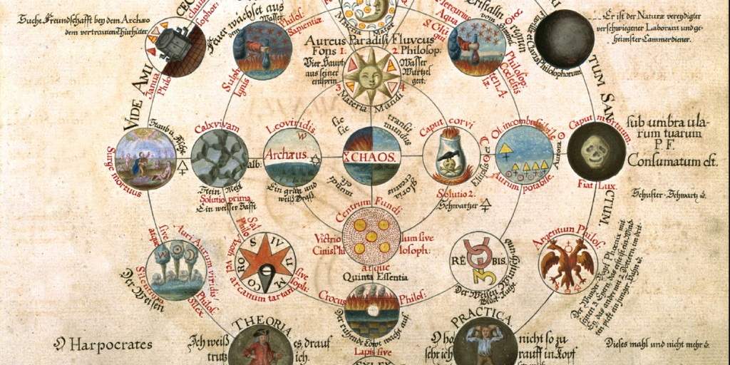
So what is spirituality?
Spirituality is a key dimension of religion both in the history of Western culture and in contemporary societies. It refers to forms of religion that:
Are focused on the individual rather than the collective.
Are concerned with the cultivation of personal experience(s) more than with legal or doctrinal matters.
Emphasize praxis rather than belief.
May challenge orthodoxy with heterodox ideas and practices.

Slide 5
And why does it matter?
Just as religious institutions may find themselves in conflict with one another, they also may come into conflict with individuals and less-institutionalized religious groups. Such encounters may be situations of tension, but also of creative transformation, often of great historical and intellectual importance.
This program offers a unique, comprehensive understanding of the social and cultural relevance of these interactions as productive of religious change.
We look not only at the perspectives of those who establish and take care of religious institutions, but also (and especially) of those who constantly challenge them from within and from without.

Slide 6
Why study spirituality and religion in Amsterdam?
  The Master’s programme in Spirituality and Religion at the University of Amsterdam is unique in the world in its exclusive focus on spirituality and religion.

Slide 7
Why study spirituality and religion in Amsterdam?
  The Master’s programme in Spirituality and Religion at the University of Amsterdam is unique in the world in its exclusive focus on spirituality and religion.
  Students will follow courses offered by the Centre for Hermetic Philosophy and Related Currents, the world-leading institute in the field.

Slide 8
Why study spirituality and religion in Amsterdam?
  The Master’s programme in Spirituality and Religion at the University of Amsterdam is unique in the world in its exclusive focus on spirituality and religion.
  Students will follow courses offered by the Centre for Hermetic Philosophy and Related Currents, the world-leading institute in the field.
  It gives the possibility to attend numerous conferences and meetings in the vibrant atmosphere of Amsterdam’s city centre.

Slide 9
Why study spirituality and religion in Amsterdam?
  The Master’s programme in Spirituality and Religion at the University of Amsterdam is unique in the world in its exclusive focus on spirituality and religion.
  Students will follow courses offered by the Centre for Hermetic Philosophy and Related Currents, the world-leading institute in the field.
  It gives the possibility to attend numerous conferences and meetings in the vibrant atmosphere of Amsterdam’s city centre.
  There are extraordinary resources for research such as the UvA library (with amazing special collections), the Embassy of the Free Mind (former Ritman Library), and the library of the Theosophical Society.

Slide 10
The structure of the 1-year MA Spirituality and Religion
Semester 1 |  |  | Semester 2
Block 1 | Block 2 | Block 3 | Block 4 | Block 5 | Block 6
Core course 1 | Core course 2 | Core course 3 | Master’s Thesis Religious Studies (18 EC)
Spirituality and religion: theories, concepts, and methods (6 EC) | Introduction to Western esotericism and spirituality (6 EC) | Spirituality and religion: lived practices (6 EC)
Elective (6 EC) | Elective (6 EC) |  | Elective (6 EC) | Elective (6 EC)

Slide 11
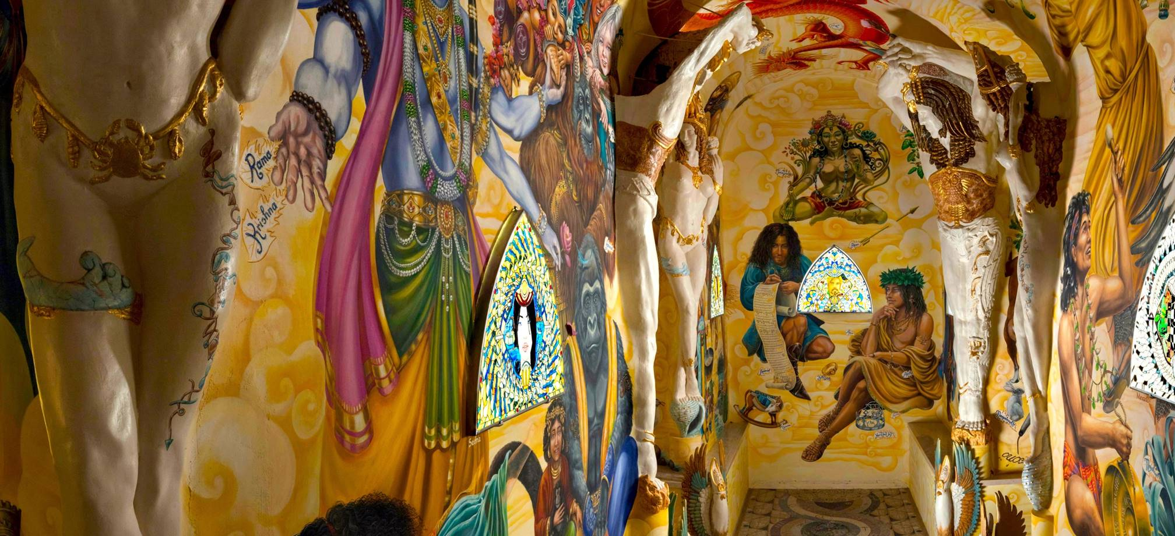
Three specialisation areas
Spirituality and Esotericism in Western Culture
Religion and Spirituality in Contemporary Societies
Spirituality and Religion in Islam

Slide 12
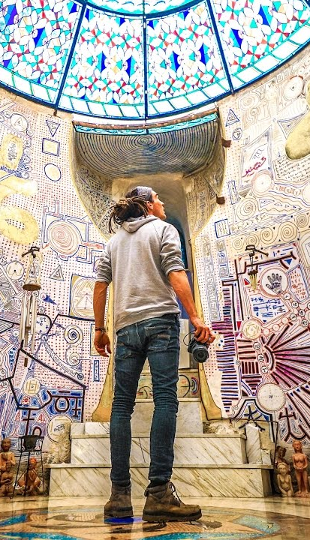
Spirituality and Esotericism in Western Culture
Specialization-specific course: Introduction to Western Esotericism and Spirituality
Main electives:
Platonic Underworlds
Islamic Esotericism and its Medieval Legacies
Renaissance Esotericism
Occult Trajectories

Slide 13
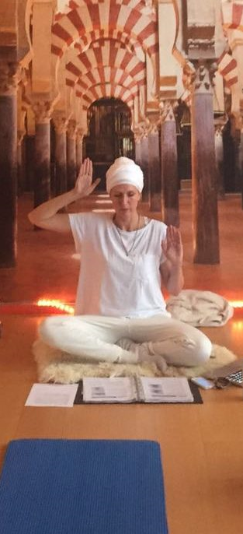
Religion and Spirituality in Contemporary Societies
Specialization-specific courses:
Religion and spirituality in contemporary societies
Practicum: Fieldwork
Main electives:
The Power of Words, Objects, and Rituals
Religion, Violence, Conflict Resolution
Urban Spiritualities Today

Slide 14
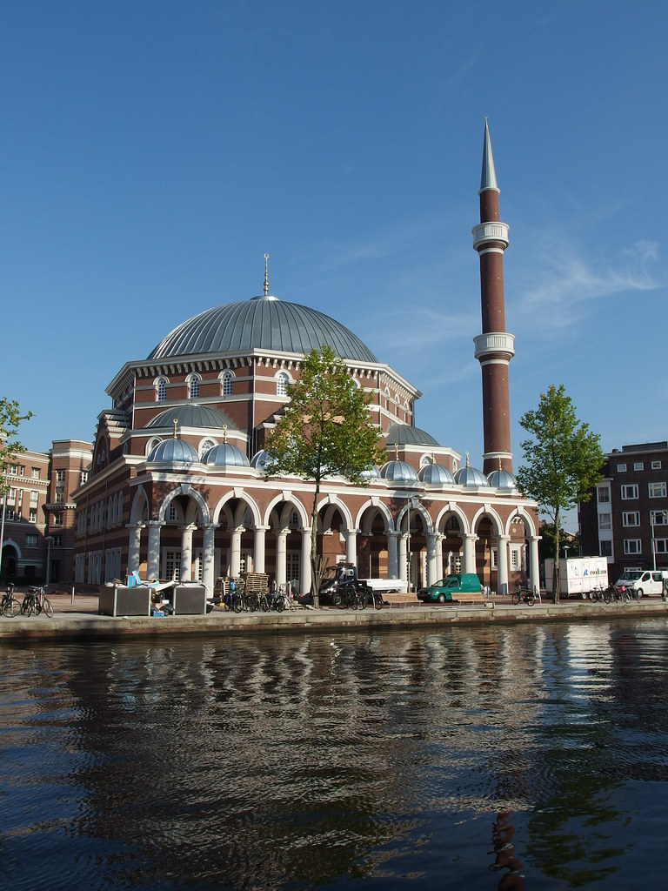
Spirituality and Religion in Islam
Specialization-specific courses:
Key debates in Islamic Studies
Main electives:
Sufism and Islamic mysticism
Islamic Esotericism and its Medieval Legacies
Anthropology of Islam, Gender, and Law
Urban Spiritualities Today

Slide 15

Research Master (2 Years)
  Methods and Theories in the Study of Religion (15 EC)
  Religious Experience (12 EC)
  Nature and the Supernatural (12 EC)
  Current Issues in Religious Studies & Western Esotericism (3 EC)

Slide 16
Research Master (2 Years)
  Electives (24 EC)
  2 Research Tutorials (12 EC)
  Participation in one of the National Research Schools (12 EC)
  MA Thesis Project (30 EC, includes 12 EC for research and 18 EC for writing the thesis)
  Total: 120 EC (European Credits)

Slide 17
15,000-23,000 words (excluding notes, bibliography and attachments)
Divine Machines: Hero of Alexandria’s Religious Technology
Bodies Fixed, Bodies Volatile: Paracelsian Elementals, Gender & Their Afterlives in (Early) Modernity
King Solomon’s Demons and Jinn: Christian and Islamic Solomonic Magic in Historical Context
Landscape and Agency in the Dindschenschas of Odras
Between Lab & Psyche: Field Research on the Practice and Psychology of Alchemy: The Analysis and Synthesis of Body, Soul, and Spirit

Slide 18

Admissions
Entry requirements
Bachelor’s degree from an accredited university in humanities or social sciences with a minimum of 30 ECTS (equivalent to a full-time semester of academic studies) in the field of Religious studies or any other area that is pertinent to the study of Spirituality and/or Religion.
Specific questions about application and admission
Mail to: AdmissionsMA-fgw@uva.nl

Slide 19
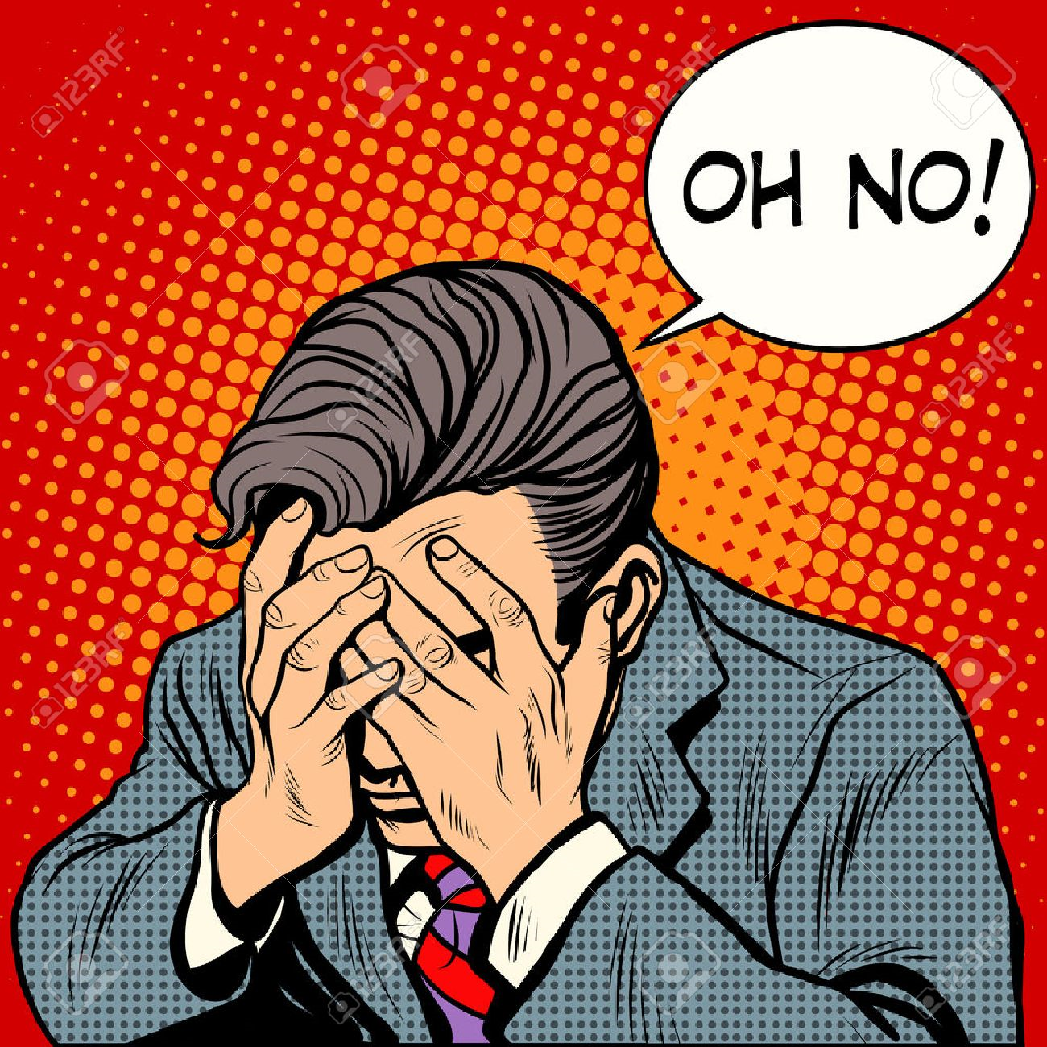
You think you don’t fulfil the entry requirements?

Slide 20

Don’t despair!
There is the pre-master.

Slide 21
After your MA Programme?
Education and teaching, particularly in the case of religion and social disciplines, as well as policy development in an educational setting.

Slide 22
After your MA Programme?
Education and teaching, particularly in the case of religion and social disciplines, as well as policy development in an educational setting.
Journalism and media

Slide 23
After your MA Programme?
Education and teaching, particularly in the case of religion and social disciplines, as well as policy development in an educational setting.
Journalism and media
Academic career (Research Master)

Slide 24
After your MA Programme?
Education and teaching, particularly in the case of religion and social disciplines, as well as policy development in an educational setting.
Journalism and media
Academic career (Research Master)
Editor in a publishing house.

Slide 25
After your MA Programme?
Education and teaching, particularly in the case of religion and social disciplines, as well as policy development in an educational setting.
Journalism and media
Academic career (Research Master)
Editor in a publishing house.
Work for government institutions at various levels, both national and international, aimed at policy development and information. These could include ministries of domestic affairs, foreign affairs, law and foreign aid, municipal government, migration policies, religious diversity and minority policies.

Slide 26
After your MA Programme?
Education and teaching, particularly in the case of religion and social disciplines, as well as policy development in an educational setting.
Journalism and media
Academic career (Research Master)
Editor in a publishing house.
Work for government institutions at various levels, both national and international, aimed at policy development and information. These could include ministries of domestic affairs, foreign affairs, law and foreign aid, municipal government, migration policies, religious diversity and minority policies.
Work for non-governmental organisations in the fields of policy development, foreign affairs, expert information, aid, mediation.

Slide 27
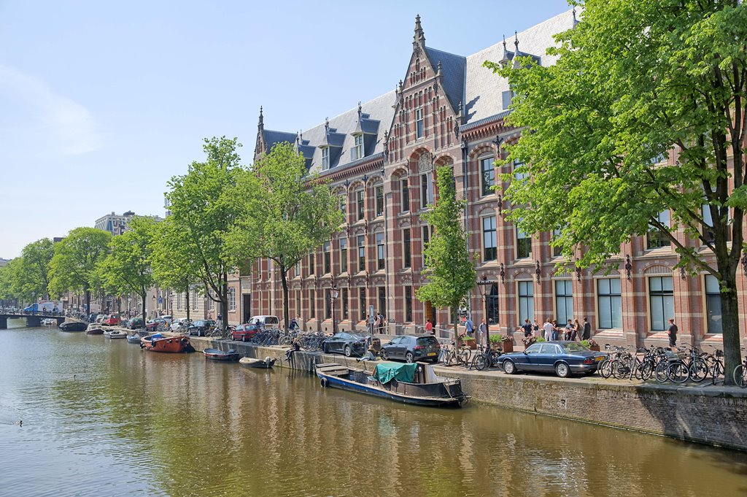
Deadlines
1-year MA
1 March 2025: All applicants with a non-EU/EEA nationality
15 May 2025: Applicants with a Dutch nationality or an EU/EEA nationality
Research Master
1 March 2025: Dutch and Foreign Nationals
* If you are an applicant with an EU/EEA nationality and wish to apply for housing, you must submit your application by 1 March 2025.
www.gsh.uva.nl

